Slide 1
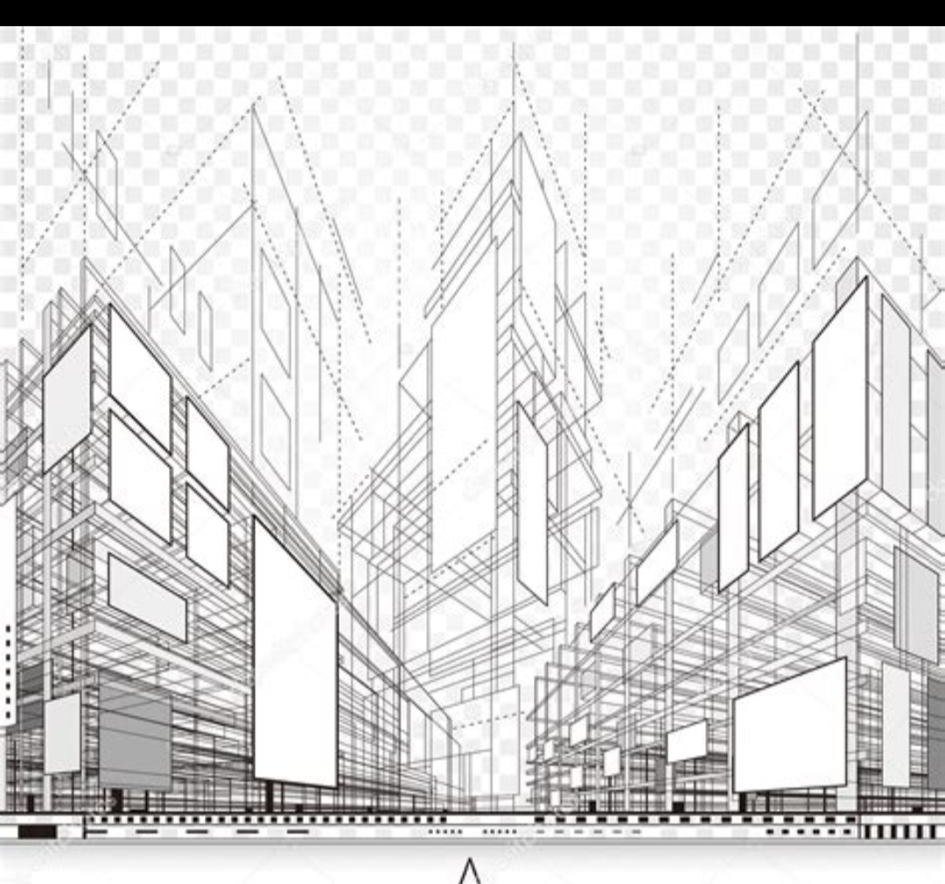
Mistahou India Private Limited
Company Overview
An architectural and engineering design firm.
Shaping real estate identity and amplifying value.
Delivering precision, elegance, and ROI-driven designs.

Slide 2
Our Vision & Mission
Clear Direction
Vision: Create signature destinations where design tells a story of
value.
Mission: Guide clients through bespoke, inspired and intelligent
design journeys.

Slide 3
Who We Serve
Our Clients
Institutional real-estate funds and developers
Family offices and private investors
Hotel, wellness and luxury retail groups
Heritage and legacy portfolio owners

Slide 4
Core Services - Architecture
Design Excellence
Master planning and feasibility studies
Concept and detailed design
Façade engineering and sustainability integration

Slide 5
Core Services - Engineering
Technical Expertise
Structural, MEP and civil engineering
Building performance analysis
Construction supervision and quality assurance

Slide 6
Core Services - Interior & Atmosphere Design
Creating Experiences
Spatial programming and bespoke fit-out
Materiality, lighting and sensory branding
FF&E specification

Slide 7
Core Services - Strategic Design Consulting
Strategic Advisory
Market positioning and brand alignment
Asset repositioning strategies
Technical due diligence and risk management

Slide 8
Our Methodology
Our Guiding Principles
Rigor: Meticulous research and project management
Inspiration: Creative and innovative exploration
Intelligence: Strategic and market aligned design choices

Slide 9
Why Choose Mistahou India
Our Edge
Multidisciplinary approach and expertise
Track record of transforming complex briefs
Client-centric culture and transparent processes

Slide 10
Our Commitment & Contact
Get in Touch
Crafting timeless and valuable architectural solutions.
Delhi, India | +919123018350
arry.mint@gmail.com | www.mfinancialg.com

